Slide 1

Parametric Modelling
Introduction to The Simplest Model,
The Algorithm and Principle
Under The Framework of Statistical Learning
林成鍇 Julius Ling @ 國立成功大學大數據與AI研究中心

Slide 2

to Prof. Po-Hsien Huang

Slide 3

Outline
Linear Regression
Logistic Regression
Model Validation

Slide 4
Outline
Linear Regression
Logistic Regression
Model Validation

Slide 5
Linear Regression
Historical Review & Conventional Use of Symbols
Intuitive Understanding & Visualization of The Model
Underneath The Bonnet
Model Evaluation

Slide 6
Linear Regression
Historical Review & Conventional Use of Symbols
Intuitive Understanding & Visualization of The Model
Underneath The Bonnet
Model Evaluation

Slide 7
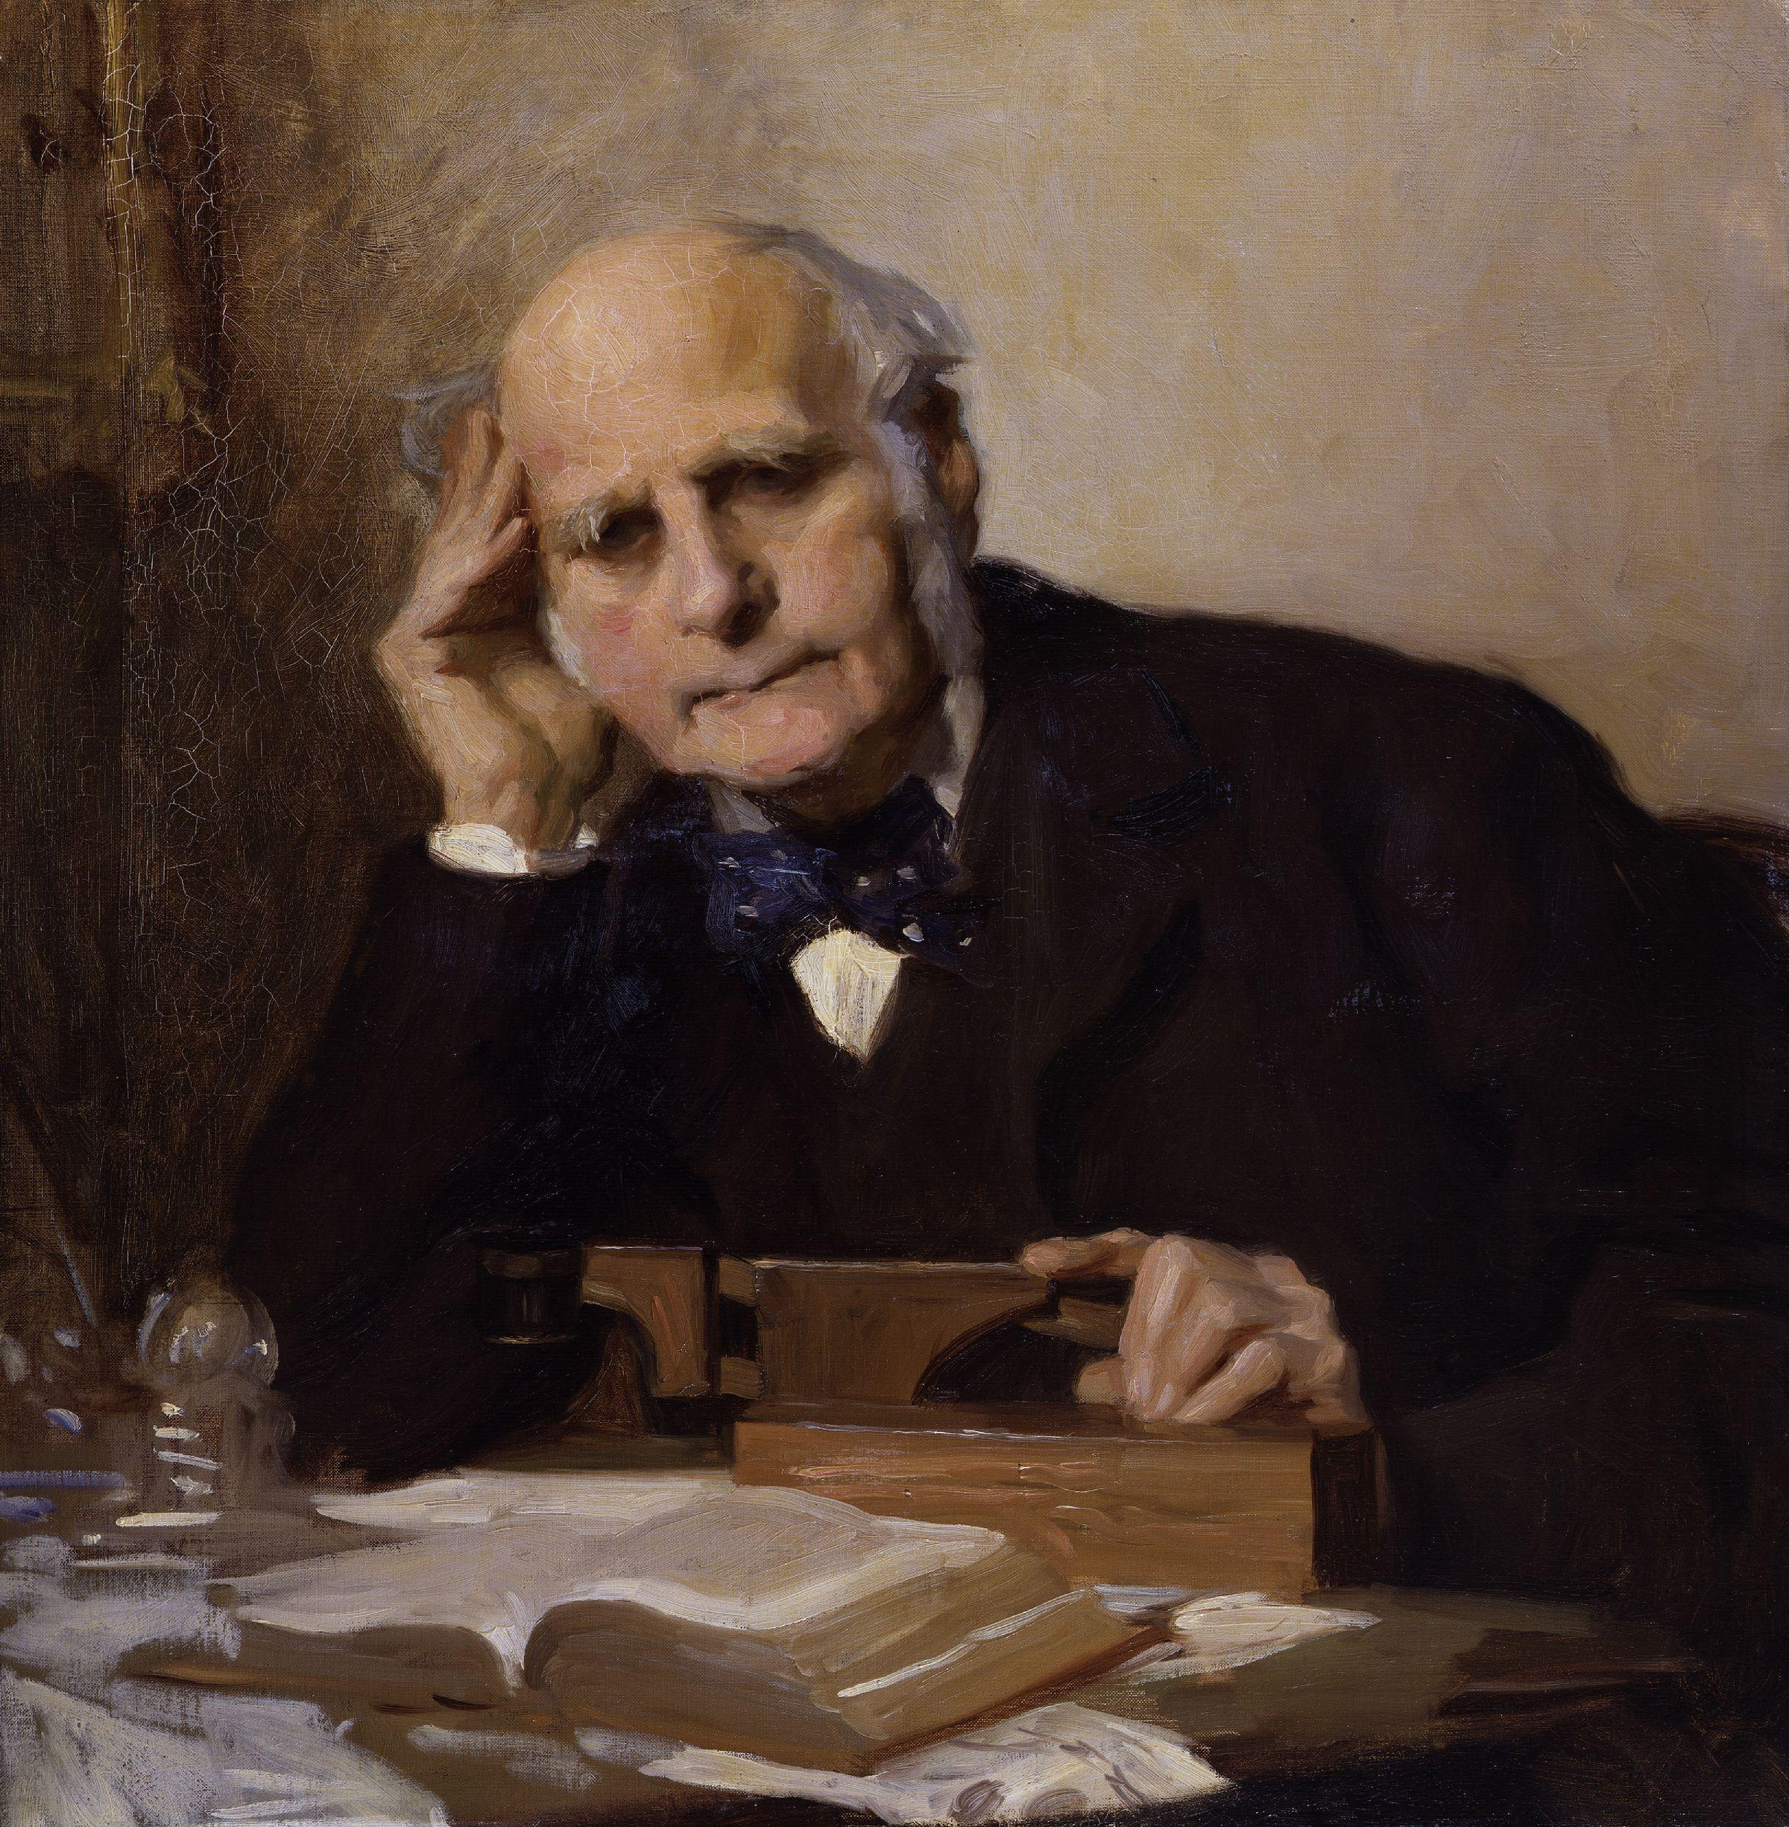
Sir Francis Galton

Slide 8

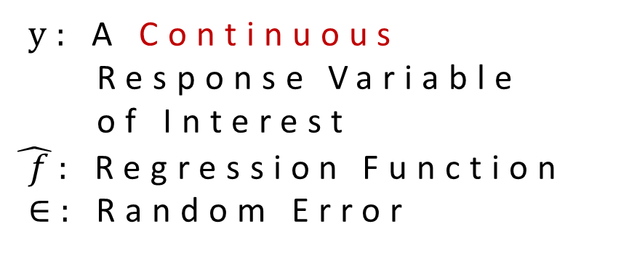
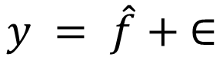
Conventional Use of Symbols
$$y = \hat{f} + ∈$$
$y:$A Continuous
Response Variable
of Interest
$\hat{ f}:$ Regression Function
$∈:$ Random Error

Slide 9
Linear Regression
Historical Review & Conventional Use of Symbols
Intuitive Understanding & Visualization of The Model
Underneath The Bonnet
Model Evaluation

Slide 10
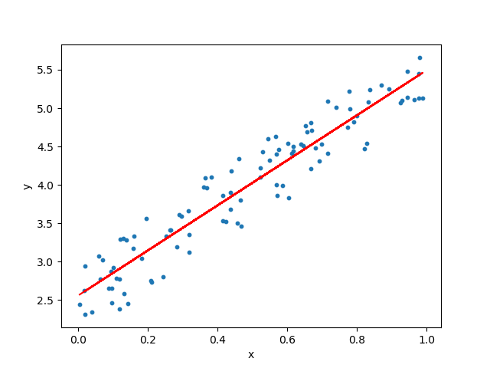
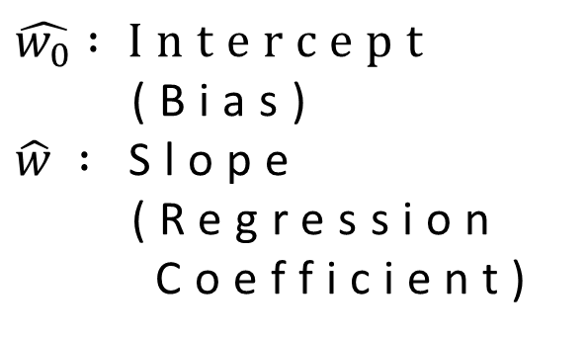

Simple Regression Model
$$\hat{f}=\hat{w_{0}}+\hat{w}x$$
$$\hat{w_{0}} :Intercept$$
(Bias)
$\hat{w} :$ Slope
(Regression
Coefficient)

Slide 11
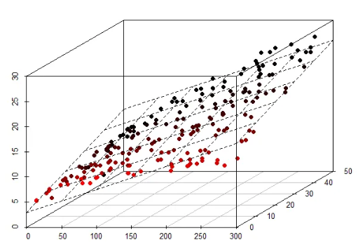
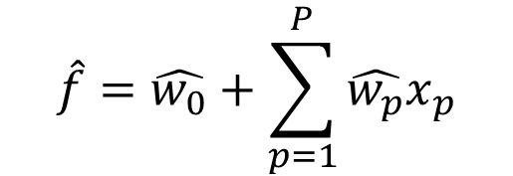
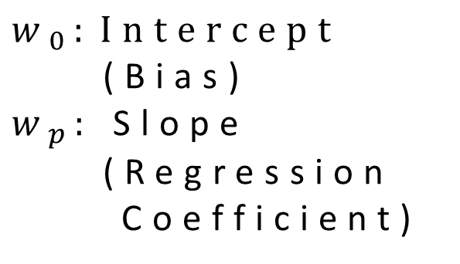
Multiple Regression Model
$$\hat{f}=\hat{w_{0}}+\sum_{p=1}^{P}{\hat{w_{p}}x_{p}}$$
$$w_{0}:Intercept$$
(Bias)
$w_{p}:$ Slope
(Regression
Coefficient)

Slide 12
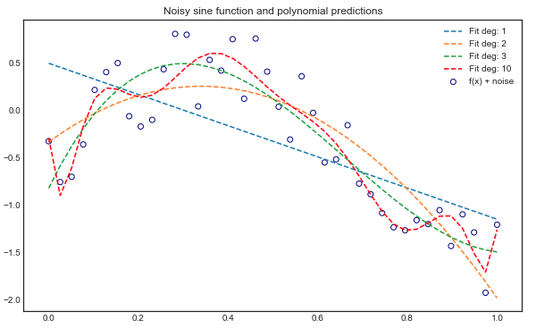
Polynomial Regression Model

Slide 13
A Bivariate Quadratic Polynomial
$$\hat{f}=\hat{w_{0}}+ \hat{w_{1}}x_{1}+ \hat{w_{2}}x_{2}+ \hat{w_{3}}x_{1}^{2}+ \hat{w_{4}}x_{1}x_{2}+ \hat{w_{5}}x_{2}^{2}$$
To fit such regression line, one must generate a design matrix containing these linear and quadratic terms with the samples.

Slide 14
Linear Regression
Historical Review & Conventional Use of Symbols
Intuitive Understanding & Visualization of The Model
Underneath The Bonnet
Model Evaluation

Slide 15
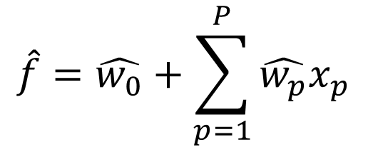

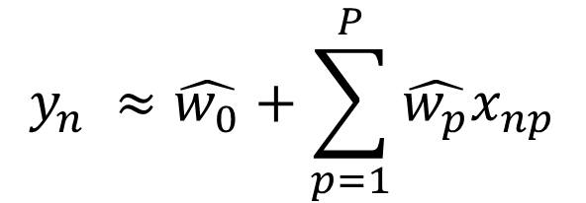
Parameter Estimation with Finite Sample
$$y_{n} ≈ \hat{f}$$
$$\hat{f}=\hat{w_{0}}+\sum_{p=1}^{P}{\hat{w_{p}}x_{p}}$$
$$y_{n} ≈\hat{w_{0}}+\sum_{p=1}^{P}{\hat{w_{p}}x_{np}}$$

Slide 16
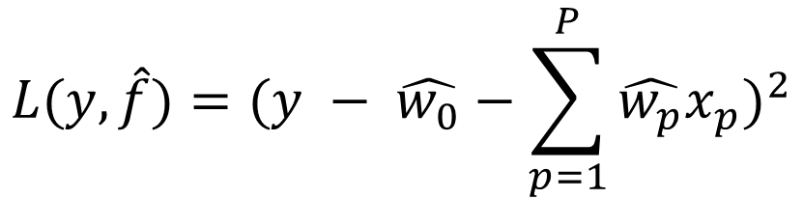
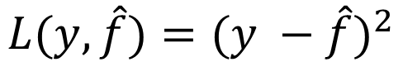
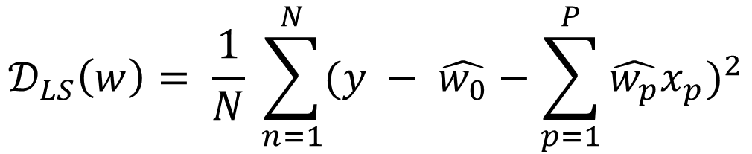
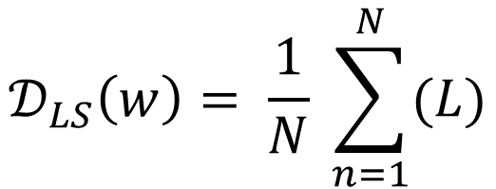
Loss Function & Least Square Estimation Criterion
$$L(y,\hat{f})={(y −\hat{f})}^{2}$$
$$L(y,\hat{f})={(y − \hat{w_{0}}−\sum_{p=1}^{P}{\hat{w_{p}}x_{p}})}^{2}$$
$$𝒟_{LS}\left(w\right)= \frac{1}{N} \sum_{n=1}^{N}{(L)}$$
$$𝒟_{LS}\left(w\right)= \frac{1}{N} \sum_{n=1}^{N}{{(y − \hat{w_{0}}−\sum_{p=1}^{P}{\hat{w_{p}}x_{p}})}^{2}}$$

Slide 17
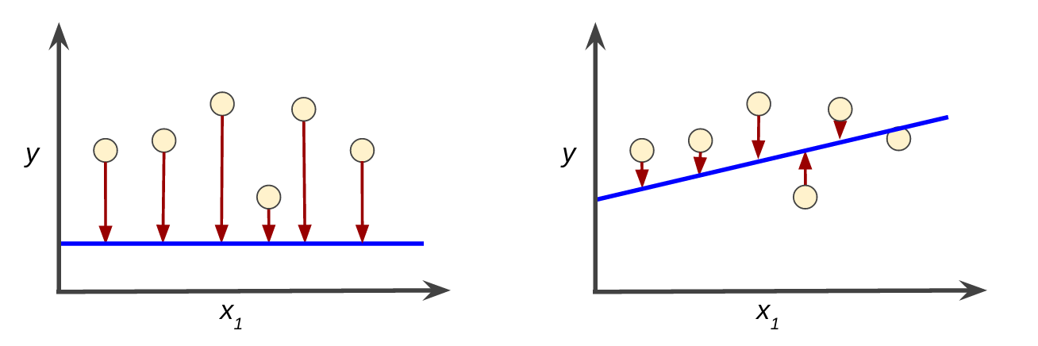
Graphical View of Squared-Error

Slide 18

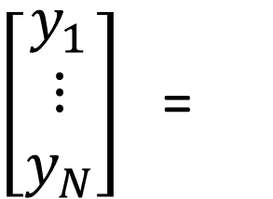
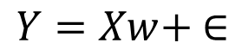
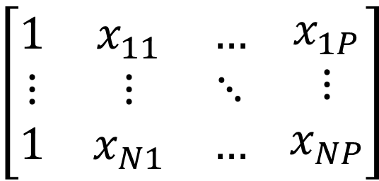
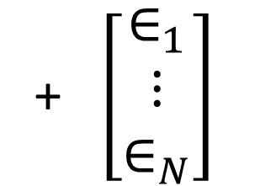
Matrix Representation of Linear Regression
$$Y=Xw+ ∈$$
$\left[\begin{matrix}y_{1} \\ ⋮ \\ y_{N}\end{matrix}\right]$ =
$$\left[\begin{matrix}1 & x_{11} & … \\ ⋮ & ⋮ & ⋱ \\ 1 & x_{N1} & …\end{matrix} \begin{matrix}x_{1P} \\ ⋮ \\ x_{NP}\end{matrix}\right]$$
+ $\left[\begin{matrix}∈_{1} \\ ⋮ \\ ∈_{N}\end{matrix}\right]$
$$\left[\begin{matrix}w_{0} \\ ⋮ \\ w_{P}\end{matrix}\right]$$
a.k.a Design Matrix

Slide 19
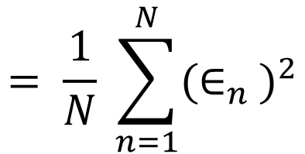
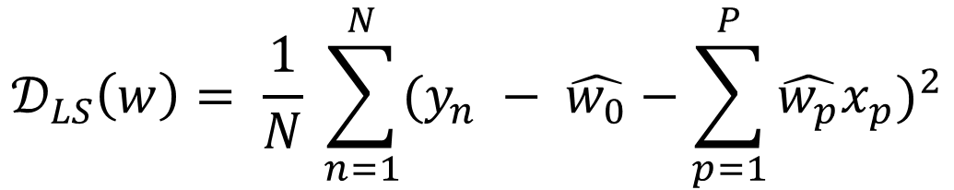
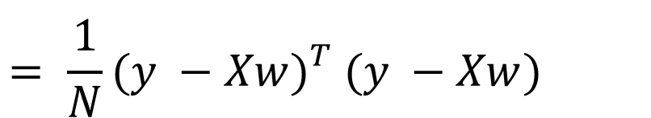
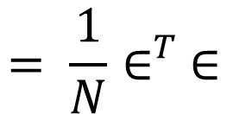
Matrix Representation of Least Square Criterion
$$𝒟_{LS}\left(w\right)= \frac{1}{N} \sum_{n=1}^{N}{{(y_{n} − \hat{w_{0}}−\sum_{p=1}^{P}{\hat{w_{p}}x_{p}})}^{2}}$$
$$= \frac{1}{N} \sum_{n=1}^{N}{{(∈_{n}^{})}^{2}}$$
$$= \frac{1}{N}∈_{}^{T}∈$$
$$= \frac{1}{N}(y −{{Xw)}_{}^{T}(y −{{Xw)}_{}^{}}^{}}^{}$$

Slide 20
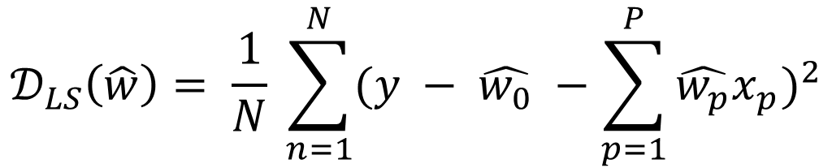
Recall: Least Square Estimation Criterion
$$𝒟_{LS}\left(\hat{w}\right)= \frac{1}{N} \sum_{n=1}^{N}{{(y − \hat{w_{0}} −\sum_{p=1}^{P}{\hat{w_{p}}x_{p}})}^{2}}$$
This is a multivariate optimization problem.

Slide 21
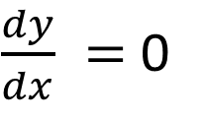
Recall: First Derivative Test
$\frac{dy}{dx} =$ 0
This is a univariate optimization problem.

Slide 22
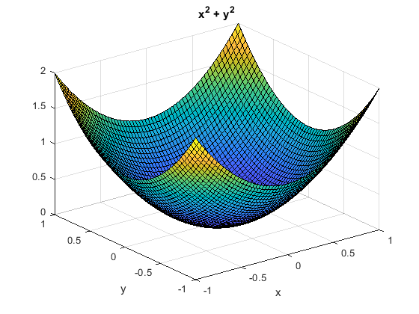
This is a bivariate optimization problem.

Slide 23
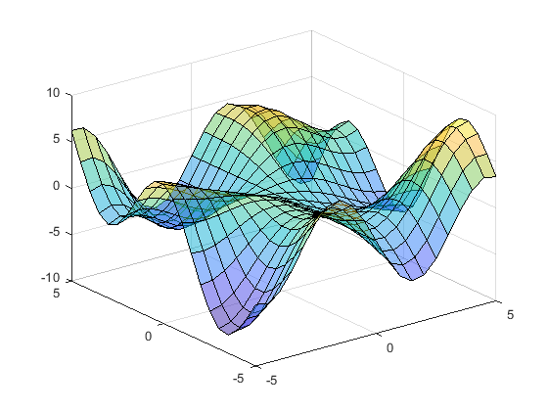
Spoiler Alert
The optimization problem could be much more
complicated than you think
(and we would encounter in the following lessons).

Slide 24
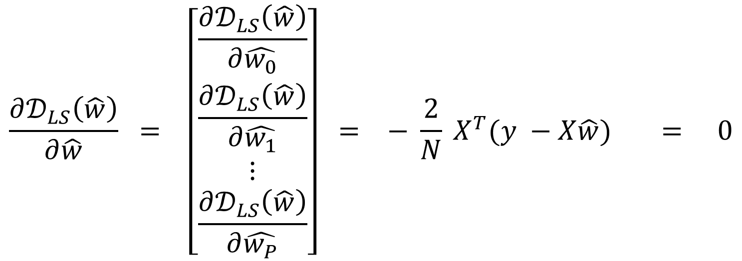
First-Order Condition for Least Square Problem
$$\frac{∂𝒟_{LS}\left(\hat{w}\right)}{∂\hat{w}} = \left[\begin{matrix}\frac{∂𝒟_{LS}\left(\hat{w}\right)}{∂\hat{w_{0}}} \\ \begin{matrix}\frac{∂𝒟_{LS}\left(\hat{w}\right)}{∂\hat{w_{1}}} \\ \begin{matrix}⋮ \\ \frac{∂𝒟_{LS}\left(\hat{w}\right)}{∂\hat{w_{P}}}\end{matrix}\end{matrix}\end{matrix}\right] = − \frac{2}{N} X^{T}(y −{{X\hat{w})}_{}^{}}^{}= 0$$

Slide 25

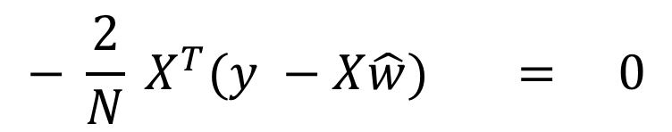

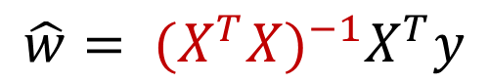
Solving The Least Square Problem
$$− \frac{2}{N} X^{T}(y −{{X\hat{w})}_{}^{}}^{}= 0$$
$$X^{T}y=X^{T}X\hat{w}$$
Normal equation of$X\hat{w}=y$
$${{{\hat{w}= (X}^{T}X)}^{−1}X}^{T}y$$
In practice, the inverse matrix ${{ (X}^{T}X)}^{−1}$ is calculated via
Gaussian elimination.

Slide 26
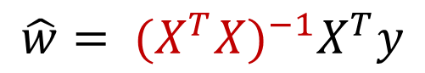
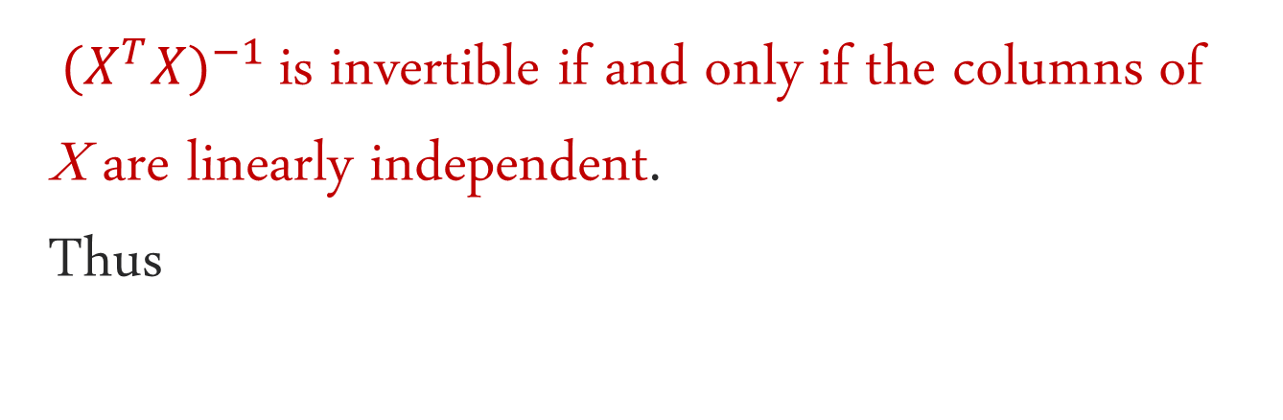
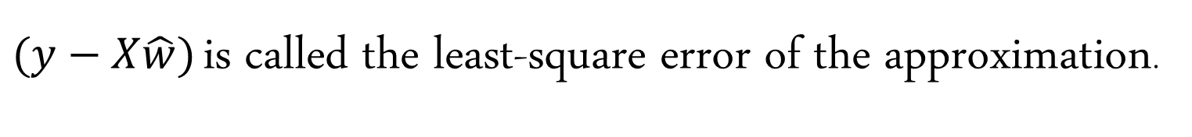
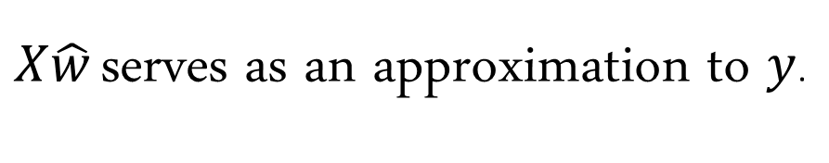
Theorem:
${{ (X}^{T}X)}^{−1}$ is invertible if and only if the columns of X are linearly independent.
Thus
$${{{\hat{w}= (X}^{T}X)}^{−1}X}^{T}y$$
$X\hat{w}$ serves as an approximation to $y$.
$(y−X\hat{w})$ is called the least-square error of the approximation.

Slide 27
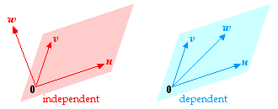

The Column Space of The Design Matrix
& Its Linear Dependency
$$\left[\begin{matrix}1 & x_{11} & … \\ ⋮ & ⋮ & ⋱ \\ 1 & x_{N1} & …\end{matrix} \begin{matrix}x_{1P} \\ ⋮ \\ x_{NP}\end{matrix}\right]$$
The column vectors form the column space of the matrix. The matrix is not invertible under the circumstance of linear dependence. It implies that you should use the least columns in representing a dummy variable.

Slide 28


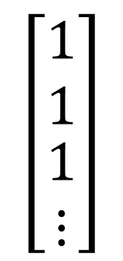
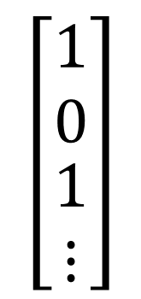


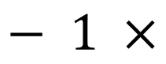
Dummy Variable Trap
$$\left[\begin{matrix}0 \\ 1 \\ \begin{matrix}0 \\ ⋮\end{matrix}\end{matrix}\right]$$
$$\left[\begin{matrix}1 \\ 1 \\ \begin{matrix}1 \\ ⋮\end{matrix}\end{matrix}\right]$$
$$\left[\begin{matrix}1 \\ 0 \\ \begin{matrix}1 \\ ⋮\end{matrix}\end{matrix}\right]$$
$$=$$
$$− 1 ×$$
A linearly dependent vector is form with the linear combination (y = c + mx) of the other vector(s) within the vector space. This illustrate the linear dependence caused by the dummy variable without dropping the first column.

Slide 29
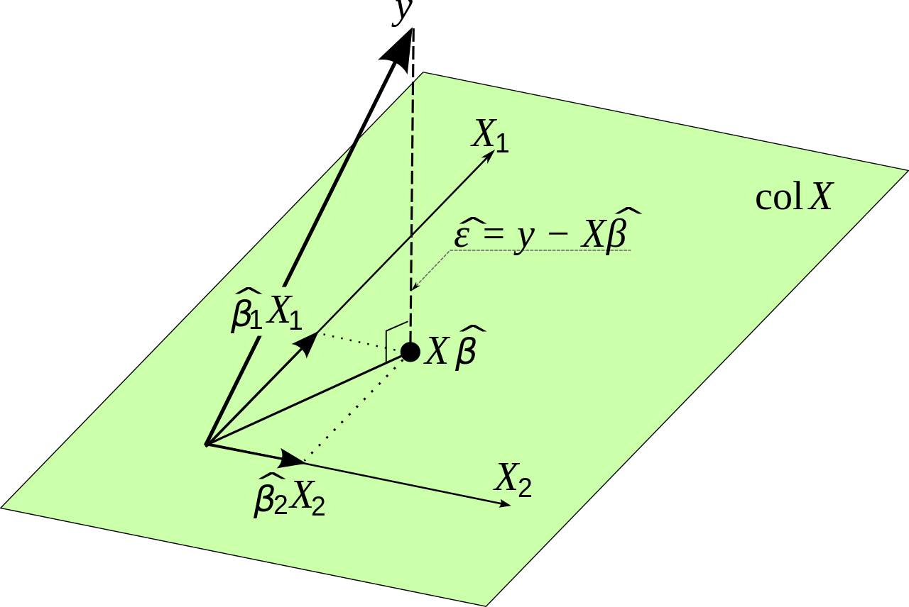
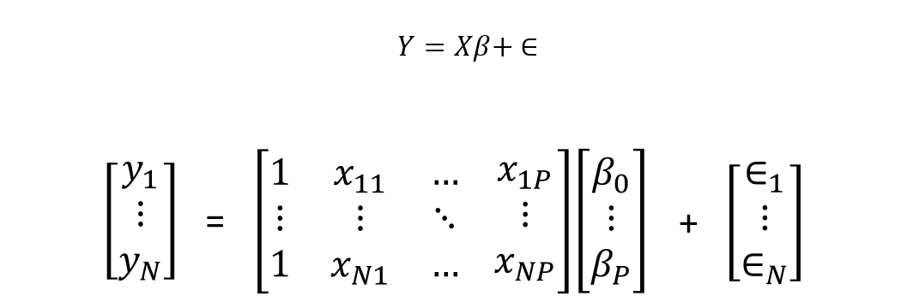
Geometrical Interpretation of
The Least Square Problem

Slide 30
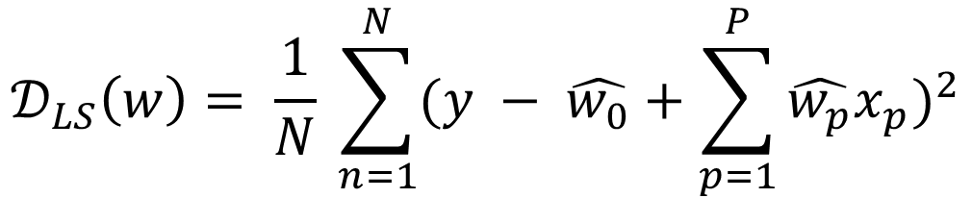
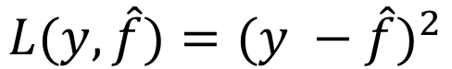
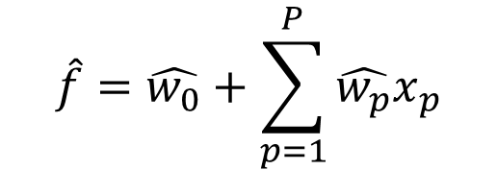
Summary
Loss Function: Mean Square Error
Optimization: Least Square Criterion
Multiple Regression Function:
$$L(y,\hat{f})={(y −\hat{f})}^{2}$$
$$𝒟_{LS}\left(w\right)= \frac{1}{N} \sum_{n=1}^{N}{{(y − \hat{w_{0}}+\sum_{p=1}^{P}{\hat{w_{p}}x_{p}})}^{2}}$$
$$\hat{f}=\hat{w_{0}}+\sum_{p=1}^{P}{\hat{w_{p}}x_{p}}$$

Slide 31
Linear Regression
Historical Review & Conventional Use of Symbols
Intuitive Understanding & Visualization of The Model
Underneath The Bonnet
Model Evaluation

Slide 32
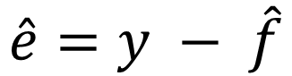
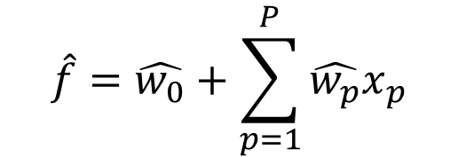
Recall: Multiple Regression Function
$$\hat{f}=\hat{w_{0}}+\sum_{p=1}^{P}{\hat{w_{p}}x_{p}}$$
Residual
$$\hat{e}=y − \hat{f}$$

Slide 33
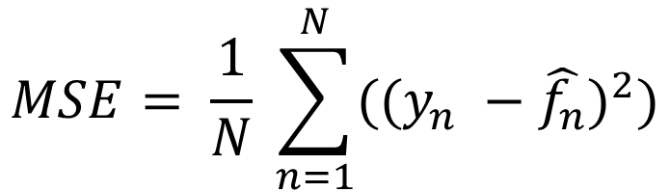
Recall: Mean Square Error
$$MSE= \frac{1}{N} \sum_{n=1}^{N}{({(y_{n} −\hat{f_{n}})}^{2})}$$
Practically we may have an insight about
how different models perform through the
difference of MSE (∆MSE).
The lower the MSE, the better the model performs

Slide 34
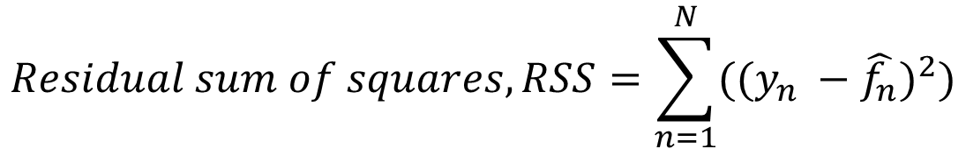
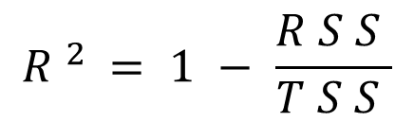
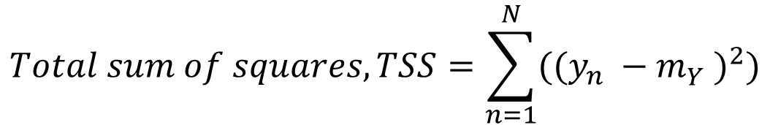
Coefficient of Determination, $R^{2}$
$$Residual sum of squares, RSS=\sum_{n=1}^{N}{({(y_{n} −\hat{f_{n}})}^{2})}$$
$$Total sum of squares, TSS=\sum_{n=1}^{N}{({(y_{n} −m_{Y}^{})}^{2})}$$
Sample mean of response variable
$$R^{2}=1−\frac{RSS}{TSS}$$
The higher the $R^{2}$, the better the model performs

Slide 35


$$m_{Y}$$
${(y}_{n} −{ m}_{Y}^{})=(y_{n} −\hat{f_{n}})$ + $(\hat{f_{n}} −{ m}_{Y}^{})$

Slide 36

Curse of Dimensionality & Data Sparsity
R-square will never decrease as the input variables (the dimensions) increase, even if the input variable itself is meaningless. Hence the interpretation of R-square is tricky multivariate regression.

Slide 37


Adjusted R-square
$$Adj. R^{2}=1 − \frac{n−1}{n−p−1}(1−R^{2})$$
$n_{}:$Sample size
$p_{}:$Number of Predictors
The Adjusted R-square will penalize the act of adding meaningless variables.

Slide 38
Outline
Linear Regression
Logistic Regression
Model Validation

Slide 39
Logistic Regression
Intuitive Understanding & Visualization of The Model
Underneath The Bonnet
Multinomial Logistic Regression
Relationship Between Logistic Regression & Deep Learning
Model Evaluation
Cost-based Classification

Slide 40
Logistic Regression
Intuitive Understanding & Visualization of The Model
Underneath The Bonnet
Multinomial Logistic Regression
Relationship Between Logistic Regression & Deep Learning
Model Evaluation
Cost-based Classification

Slide 41


What is Modelling？
What are we about to Model?

Slide 42

Binary Classification Task

Slide 43

Binary Classification Task

Slide 44


Logistic Function & Logistic Regression
Logistic Function is called
Sigmoid Function as well.
Decision
Boundary

Slide 45

Logistic Function & Its Derivative

Slide 46


Simple Logistic Regression Model
$$ℙ\left(y=A | x\right)= \frac{e^{(\hat{w_{0}}+ \hat{w}x)}}{1+e^{(\hat{w_{0}}+ \hat{w}x)}}$$

Slide 47

Logistic Regression Model (General)
$$ℙ\left(y=A | x\right)= \frac{e^{(\hat{w_{0}}+\sum_{p=1}^{P}{{\hat{w}}_{p}x_{p}})}}{1+e^{(\hat{w_{0}}+\sum_{p=1}^{P}{{\hat{w}}_{p}x_{p}})}}$$

Slide 48



For a binary classification task,
a subject is either classify as class A or B.
There is nowhere in between.
$$ℙ\left(y=A | x\right)= \frac{e^{(\hat{w_{0}}+\sum_{p=1}^{P}{{\hat{w}}_{p}x_{p}})}}{1+e^{(\hat{w_{0}}+\sum_{p=1}^{P}{{\hat{w}}_{p}x_{p}})}}$$
$$ℙ\left(y=B | x\right)=1 − \frac{e^{(\hat{w_{0}}+\sum_{p=1}^{P}{{\hat{w}}_{p}x_{p}})}}{1+e^{(\hat{w_{0}}+\sum_{p=1}^{P}{{\hat{w}}_{p}x_{p}})}}$$
$$= \frac{1}{1+e^{(\hat{w_{0}}+\sum_{p=1}^{P}{{\hat{w}}_{p}x_{p}})}}$$

Slide 49


The distribution of y given x is a
Bernoulli Distribution
$$ℙ\left(y | x\right)= {\left[\frac{e^{(\hat{w_{0}}+\sum_{p=1}^{P}{{\hat{w}}_{p}x_{p}})}}{1+e^{(\hat{w_{0}}+\sum_{p=1}^{P}{{\hat{w}}_{p}x_{p}})}}\right]}^{u_{A}}{\left[\frac{1}{1+e^{(\hat{w_{0}}+\sum_{p=1}^{P}{{\hat{w}}_{p}x_{p}})}}\right]}^{u_{B}}$$
Where $u_{}$=($u_{A}$ ${,u}_{B}$)is a one-hot encoding for y:
$$u_{i}= \left\{ \begin{aligned}1, if y=i \\ 0, otherwise\end{aligned}\right.$$

Slide 50


Odds & Weight Interpretation
$$\frac{ℙ\left(y=A | x\right)}{ℙ\left(y=B | x\right)}= \frac{\frac{e^{(\hat{w_{0}}+\sum_{p=1}^{P}{{\hat{w}}_{p}x_{p}})}}{1+e^{(\hat{w_{0}}+\sum_{p=1}^{P}{{\hat{w}}_{p}x_{p}})}}}{\frac{1}{1+e^{(\hat{w_{0}}+\sum_{p=1}^{P}{{\hat{w}}_{p}x_{p}})}}}= e^{(\hat{w_{0}}+\sum_{p=1}^{P}{{\hat{w}}_{p}x_{p}})}$$
Odds
$$\log\left[\frac{ℙ\left(y=A | x\right)}{ℙ\left(y=B | x\right)}\right] = \hat{w_{0}}+\sum_{p=1}^{P}{{\hat{w}}_{p}x_{p}}$$
Log-Odds

Slide 51
Logistic Regression

Slide 52
Logistic Regression
Intuitive Understanding & Visualization of The Model
Underneath The Bonnet
Multinomial Logistic Regression
Relationship Between Logistic Regression & Deep Learning
Model Evaluation
Cost-based Classification

Slide 53
Probability & Likelihood
Probability is what is normalized to sum up to one, naturally by itself,
or through the way the model has been constructed.
Probability defines a distribution.
Likelihood can be used to gauge how likely an event is, and compare
which of two events is more likely. But it's not a probability, and
it does not define a probability distribution.

Slide 54

Probability & Likelihood

Slide 55


Probability & Likelihood
Presumably $ℙ\left(Head\right)=ℙ\left(Tail\right)=0.5$
9 X Head，1 X Tail
Likelihood: $ℂ_{9}^{10} {\left(0.5\right)}^{9}{\left(0.5\right)}^{1}=10{\left(0.5\right)}^{10}$
5 X Head，5 X Tail
Likelihood: $ℂ_{5}^{10} {\left(0.5\right)}^{5}{\left(0.5\right)}^{5}=252{\left(0.5\right)}^{10}$
This is more likely to have happened

Slide 56


Maximum Likelihood Estimation
$$ℙ\left(y | x\right)= {\left[\frac{e^{(\hat{w_{0}}+\sum_{p=1}^{P}{{\hat{w}}_{p}x_{p}})}}{1+e^{(\hat{w_{0}}+\sum_{p=1}^{P}{{\hat{w}}_{p}x_{p}})}}\right]}^{u_{A}}{\left[1 − \frac{e^{(\hat{w_{0}}+\sum_{p=1}^{P}{{\hat{w}}_{p}x_{p}})}}{1+e^{(\hat{w_{0}}+\sum_{p=1}^{P}{{\hat{w}}_{p}x_{p}})}}\right]}^{u_{B}}$$
$$𝒟_{ML}\left(\hat{w}\right)=−\frac{1}{N} \sum_{n=1}^{N}{\left\{u_{nA}\log\left[\frac{e^{(\hat{w_{0}}+\sum_{p=1}^{P}{{\hat{w}}_{p}x_{p}})}}{1+e^{(\hat{w_{0}}+\sum_{p=1}^{P}{{\hat{w}}_{p}x_{p}})}}\right]+u_{nB}\log\left[1 − \frac{e^{(\hat{w_{0}}+\sum_{p=1}^{P}{{\hat{w}}_{p}x_{p}})}}{1+e^{(\hat{w_{0}}+\sum_{p=1}^{P}{{\hat{w}}_{p}x_{p}})}}\right]\right\}}$$
In logistic regression, the model parameters $\left(\hat{w}\right)$
are estimated by minimizing the
negative maximum likelihood criterion.

Slide 57


$$𝒟_{ML}\left(\hat{w}\right)=−\frac{1}{N}\sum_{n=1}^{N}{\left\{u_{nA}\log\left[\frac{e^{(\hat{w_{0}}+\sum_{p=1}^{P}{{\hat{w}}_{p}x_{p}})}}{1+e^{(\hat{w_{0}}+\sum_{p=1}^{P}{{\hat{w}}_{p}x_{p}})}}\right]+u_{nB}\log\left[1 − \frac{e^{(\hat{w_{0}}+\sum_{p=1}^{P}{{\hat{w}}_{p}x_{p}})}}{1+e^{(\hat{w_{0}}+\sum_{p=1}^{P}{{\hat{w}}_{p}x_{p}})}}\right]\right\}}$$
$$𝒟_{ML}\left(\hat{w}\right)=−\frac{1}{N}log\left[\prod_{n=1}^{N}{ℙ\left(y_{n} | x_{n}\right)}\right]$$
Several observation to be taken note of:
$ℙ\left(y_{n} | x_{n}\right)$is a Bernoulli Distribution
$\prod_{n=1}^{N}{ℙ\left(y_{n} | x_{n}\right)}$is the joint probability under the presumption of independence (Likelihood Function)
($−log$) is mere rescaling of the optimization problem

Slide 58


Matrix Representation of
The Log-Likelihood Function
$$𝒟_{ML}\left(\hat{w}\right)=−\frac{1}{N}\sum_{n=1}^{N}{\left\{u_{nA}\log\left[\frac{e^{(\hat{w_{0}}+\sum_{p=1}^{P}{{\hat{w}}_{p}x_{p}})}}{1+e^{(\hat{w_{0}}+\sum_{p=1}^{P}{{\hat{w}}_{p}x_{p}})}}\right]+u_{nB}\log\left[1 − \frac{e^{(\hat{w_{0}}+\sum_{p=1}^{P}{{\hat{w}}_{p}x_{p}})}}{1+e^{(\hat{w_{0}}+\sum_{p=1}^{P}{{\hat{w}}_{p}x_{p}})}}\right]\right\}}$$
Let $σ\left(x\right)=\frac{e^{x}}{1+e^{x}}$
$$𝒟_{ML}\left(\hat{w}\right)=−\frac{1}{N}\sum_{n=1}^{N}{\left\{u_{nA}\log\left[σ\left(X_{n}\hat{w}\right)\right]+u_{nB}\log\left[1 −σ\left(X_{n}\hat{w}\right)\right]\right\}}$$
$$𝒟_{ML}\left(\hat{w}\right)=−\frac{1}{N}\sum_{n=1}^{N}{\left\{u_{nA}\log\left[σ\left(\left[\begin{matrix}1 & x_{n1} & \begin{matrix}⋯ & x_{nP}\end{matrix}\end{matrix}\right]\left[\begin{matrix}{\hat{w}}_{0} \\ ⋮ \\ {\hat{w}}_{P}\end{matrix}\right]\right)\right]+u_{nB}\log\left[1 −σ\left(\left[\begin{matrix}1 & x_{n1} & \begin{matrix}⋯ & x_{nP}\end{matrix}\end{matrix}\right]\left[\begin{matrix}{\hat{w}}_{0} \\ ⋮ \\ {\hat{w}}_{P}\end{matrix}\right]\right)\right]\right\}}$$
We wish to find the set of $\left[\begin{matrix}{\hat{w}}_{0} \\ ⋮ \\ {\hat{w}}_{P}\end{matrix}\right]$ which minimize $𝒟_{ML}\left(\hat{w}\right)$.

Slide 59
Recall: First Derivative Test
$\frac{dy}{dx} =$ 0
This is a univariate optimization problem.

Slide 60


$$𝒟_{ML}\left(\hat{w}\right)=−\frac{1}{N}\sum_{n=1}^{N}{\left\{u_{nA}\log\left[σ\left(X_{n}\hat{w}\right)\right]+u_{nB}\log\left[1 −σ\left(X_{n}\hat{w}\right)\right]\right\}}$$
We wish to minimize $𝒟_{ML}\left(\hat{w}\right)$ in a pretty similar way
by solving the First-Order Condition (FOC):
$${𝒟^{′}}_{ML}\left(\hat{w}\right)=0$$
However, we’re unable to solve the FOC in a closed form method. Thus, we the algorithm to approximate the root of the FOC:
The Newton Method.

Slide 61







Derivation of The Log-Likelihood Function
Let:
$$z_{n} =X_{n}\hat{w}$$
$$σ_{n} = \frac{e^{z_{n}^{}}}{1+e^{z_{n}^{}}}$$
$$𝒟_{ML} =−\sum_{n=1}^{N}{(u_{A}\log\left[σ_{n}\right]+u_{B}\log\left[1 −σ_{n}\right])}$$
Evaluate the first derivative with the chain rule: $\frac{∂𝒟_{ML}}{∂\hat{w_{p}}} =−\sum_{n=1}^{N}{\frac{∂𝒟_{ML}}{∂σ_{n}} ∙ \frac{∂σ_{n}}{∂z_{n}} ∙ \frac{∂z_{n}}{∂\hat{w_{p}}}}$
$$\frac{∂𝒟_{ML}}{∂σ_{n}}=\frac{{−u}_{nA}}{σ_{n}} + \frac{u_{nB}}{1−σ_{n}}$$
Recall: $u_{}$=($u_{A}$ ${,u}_{B})$ is a one-hot encoding for y
if $u_{A}$ = 1, $u_{B}$ = 0
${ u}_{B}$ = 1 - $u_{A}$
$$\frac{∂σ_{n}}{∂z_{n}}=σ_{n}\text{(1 − }σ_{n}\text{)}$$
$$\frac{∂z_{n}}{∂\hat{w_{p}}}=x_{np}$$

Slide 62






$$\frac{∂𝒟_{ML}}{∂\hat{w_{p}}} =−\sum_{n=1}^{N}{\frac{∂𝒟_{ML}}{∂σ_{n}} ∙ \frac{∂σ_{n}}{∂z_{n}} ∙ \frac{∂z_{n}}{∂\hat{w_{p}}}}$$
$$\frac{∂𝒟_{ML}}{∂σ_{n}}=\frac{{−u}_{nA}}{σ_{n}} + \frac{u_{nB}}{1−σ_{n}}$$
Recall: $u_{}$=($u_{A}$ ${,u}_{B})$ is a one-hot encoding for y
if $u_{A}$ = 1, $u_{B}$ = 0
${ u}_{B}$ = 1 - $u_{A}$
$$\frac{∂σ_{n}}{∂z_{n}}=σ_{n}\text{(1 − }σ_{n}\text{)}$$
$$\frac{∂z_{n}}{∂\hat{w_{p}}}=x_{np}$$
$\frac{∂𝒟_{ML}}{∂\hat{w_{p}}}=−\sum_{n=1}^{N}{\left(\frac{{−u}_{nA}}{σ_{n}} + \frac{{1−u}_{nA}}{1−σ_{n}}\right) ∙ \left(σ_{n}\text{(1 − }σ_{n}\text{)}\right)∙ }$ $x_{np}$
$=\sum_{n=1}^{N}{\left(σ_{n} −u_{nA}\right)∙ x_{np}}$
First-Order Condition: $\frac{∂𝒟_{ML}}{∂\hat{w_{p}}}=\sum_{n=1}^{N}{\left(σ_{n} −u_{nA}\right)∙ x_{np}}=0$

Slide 63


First-Order Condition: $\frac{∂𝒟_{ML}}{∂\hat{w_{p}}}=\sum_{n=1}^{N}{\left(σ_{n} −u_{nA}\right)∙ x_{np}}=0$
The FOC is called Jacobian function as well.
We can construct the Jacobian matrix , $∇J\left(\hat{w}\right)$, based on it.
The Jacobian matrix indicates the gradient of $𝒟_{ML}$.
$$∇J\left(\hat{w}\right)=\left[\begin{matrix}\frac{∂𝒟_{ML}}{∂\hat{w_{0}}} \\ \begin{matrix}\frac{∂𝒟_{ML}}{∂\hat{w_{1}}} \\ ⋮\end{matrix} \\ \frac{∂𝒟_{ML}}{∂\hat{w_{p}}}\end{matrix}\right]$$

Slide 64

Second Derivative Test &
The Concavity of A Function

Slide 65

Newton Method（a.k.a Gradient Descent）

Slide 66



Newton Method
Given a function $y=f\left(x\right)$,
The Gradient of the Tangent line to $f(x)$ at point $\left(x_{n}, y_{n}\right)$= $f^{′}\left(x_{n}\right)$
The Tangent line: $y=f^{′}\left(x_{n}\right)\left(x−x_{n}\right)+f(x_{n})$
Find the x-intercept $x_{n+1}$, by letting $y=0$,
$$0=f^{′}\left(x_{n}\right)\left(x_{n+1}−x_{n}\right)+f\left(x_{n}\right)$$
$$x_{n+1}=x_{n}−\frac{f(x_{n})}{f^{′}\left(x_{n}\right)}$$
Find the y-value at $x_{n+1}$: $y_{n+1}=f(x_{n+1})$,
Repeat the process till $y_{n+1}−y_{n}≈0$

Slide 67



First-Order Condition: $\frac{∂𝒟_{ML}}{∂\hat{w_{p}}}=\sum_{n=1}^{N}{\left(σ_{n} −u_{nA}\right)∙ x_{np}}=0$
$$\frac{∂𝒟_{ML}}{∂\hat{w_{p}}}=\sum_{n=1}^{N}{\left(σ_{n}(z_{n}(\hat{w})) −u_{nA}\right)∙ x_{np}}=0$$
To apply the Newton Method in approximating the root of the FOC,
we derive the FOC (2nd derivative of $𝒟_{ML}$) and construct a Hessian matrix, H.
$$H(∇J)=\left[\begin{matrix}\frac{∂𝒟_{ML}}{∂\hat{w_{0}∂\hat{w_{0}}}} & \begin{matrix}\frac{∂𝒟_{ML}}{∂\hat{w_{0}∂\hat{w_{1}}}} & ⋯\end{matrix} & \frac{∂𝒟_{ML}}{∂\hat{w_{0}∂\hat{w_{P}}}} \\ \begin{matrix}\frac{∂𝒟_{ML}}{∂\hat{w_{1}∂\hat{w_{0}}}} \\ ⋮\end{matrix} & \begin{matrix}\frac{∂𝒟_{ML}}{∂\hat{w_{1}∂\hat{w_{1}}}} & ⋯ \\ ⋮ & ⋱\end{matrix} & \begin{matrix}\frac{∂𝒟_{ML}}{∂\hat{w_{1}∂\hat{w_{P}}}} \\ ⋮\end{matrix} \\ \frac{∂𝒟_{ML}}{∂\hat{w_{P}∂\hat{w_{0}}}} & \begin{matrix}\frac{∂𝒟_{ML}}{∂\hat{w_{P}∂\hat{w_{1}}}} & ⋯\end{matrix} & \frac{∂𝒟_{ML}}{∂\hat{w_{P}∂\hat{w_{P}}}}\end{matrix}\right]$$

Slide 68


$$H(∇J)=\left[\begin{matrix}\frac{∂𝒟_{ML}}{∂\hat{w_{0}∂\hat{w_{0}}}} & \begin{matrix}\frac{∂𝒟_{ML}}{∂\hat{w_{0}∂\hat{w_{1}}}} & ⋯\end{matrix} & \frac{∂𝒟_{ML}}{∂\hat{w_{0}∂\hat{w_{P}}}} \\ \begin{matrix}\frac{∂𝒟_{ML}}{∂\hat{w_{1}∂\hat{w_{0}}}} \\ ⋮\end{matrix} & \begin{matrix}\frac{∂𝒟_{ML}}{∂\hat{w_{1}∂\hat{w_{1}}}} & ⋯ \\ ⋮ & ⋱\end{matrix} & \begin{matrix}\frac{∂𝒟_{ML}}{∂\hat{w_{1}∂\hat{w_{P}}}} \\ ⋮\end{matrix} \\ \frac{∂𝒟_{ML}}{∂\hat{w_{P}∂\hat{w_{0}}}} & \begin{matrix}\frac{∂𝒟_{ML}}{∂\hat{w_{P}∂\hat{w_{1}}}} & ⋯\end{matrix} & \frac{∂𝒟_{ML}}{∂\hat{w_{P}∂\hat{w_{P}}}}\end{matrix}\right]$$
It could be shown that $𝒟_{ML}\left(\hat{w}\right)$ is strictly convex with the Definiteness of the Hessian Matrix.

Slide 69


Newton Method: $x_{n+1}=x_{n}−\frac{f(x_{n})}{f^{′}\left(x_{n}\right)}$
Learning Rate
In the Logistic Regression Case:
$$∴Every update for \hat{w}: \hat{w_{t+1}}=\hat{w_{t}} −{αH}^{−1}∇J\left(\hat{w}\right)$$
$$\hat{w_{t+1}}=\hat{w_{t}} −{α\left[\begin{matrix}\frac{∂𝒟_{ML}}{∂\hat{w_{0}∂\hat{w_{0}}}} & \begin{matrix}\frac{∂𝒟_{ML}}{∂\hat{w_{0}∂\hat{w_{1}}}} & ⋯\end{matrix} & \frac{∂𝒟_{ML}}{∂\hat{w_{0}∂\hat{w_{P}}}} \\ \begin{matrix}\frac{∂𝒟_{ML}}{∂\hat{w_{1}∂\hat{w_{0}}}} \\ ⋮\end{matrix} & \begin{matrix}\frac{∂𝒟_{ML}}{∂\hat{w_{1}∂\hat{w_{1}}}} & ⋯ \\ ⋮ & ⋱\end{matrix} & \begin{matrix}\frac{∂𝒟_{ML}}{∂\hat{w_{1}∂\hat{w_{P}}}} \\ ⋮\end{matrix} \\ \frac{∂𝒟_{ML}}{∂\hat{w_{P}∂\hat{w_{0}}}} & \begin{matrix}\frac{∂𝒟_{ML}}{∂\hat{w_{P}∂\hat{w_{1}}}} & ⋯\end{matrix} & \frac{∂𝒟_{ML}}{∂\hat{w_{P}∂\hat{w_{P}}}}\end{matrix}\right]}^{−1}\left[\begin{matrix}\frac{∂𝒟_{ML}}{∂\hat{w_{0}}} \\ \begin{matrix}\frac{∂𝒟_{ML}}{∂\hat{w_{1}}} \\ ⋮\end{matrix} \\ \frac{∂𝒟_{ML}}{∂\hat{w_{p}}}\end{matrix}\right]$$

Slide 70
①
②
③
Learning Rate
$$∴Every update for \hat{w}: \hat{w_{t+1}}=\hat{w_{t}} −{αH}^{−1}∇J\left(\hat{w}\right)$$

Slide 71


Recall: Linear Regression Problem is optimized
through solving the following equation:
$${{{\hat{w}= (X}^{T}X)}^{−1}X}^{T}y$$
while Logistic Regression Problem is optimized
through iteration of weight updates:
$$\hat{w_{t+1}}=\hat{w_{t}} −{αH}^{−1}∇J\left(\hat{w}\right)$$

Slide 72


Though we are unable to
bird’s-eye view the surface
but with more and more
iteration of weight updates
we are to reach the theoretical
lowest point of the terrain.
$$\hat{w_{t+1}}=\hat{w_{t}} −{αH}^{−1}∇J\left(\hat{w}\right)$$

Slide 73


Summary
Probability and Likelihood
Optimization: Maximum Likelihood Estimation
Weight Updates:
$$𝒟_{ML}\left(\hat{w}\right)=−\frac{1}{N}log\left[\prod_{n=1}^{N}{ℙ\left(y_{n} | x_{n}\right)}\right]$$
$$\hat{w_{t+1}}=\hat{w_{t}} −{αH}^{−1}∇J\left(\hat{w}\right)$$

Slide 74
Logistic Regression
Intuitive Understanding & Visualization of The Model
Underneath The Bonnet
Multinomial Logistic Regression
Relationship Between Logistic Regression & Deep Learning
Model Evaluation
Cost-based Classification

Slide 75

Multinomial Logistic Regression

Slide 76



Recall: A Binary Logistic Regression Classifier
$$ℙ\left(y=A | x\right)=\frac{e^{(\hat{w_{0}}+\sum_{p=1}^{P}{{\hat{w}}_{p}x_{p}})}}{1+e^{(\hat{w_{0}}+\sum_{p=1}^{P}{{\hat{w}}_{p}x_{p}})}}=1 −ℙ\left(y=B | x\right)$$
In comparison with an $I$-class
Multinomial Logistic Regression Classifier
$$ℙ\left(y=α | x\right)=\frac{e^{(\hat{w_{α0}}+\sum_{p=1}^{P}{{\hat{w}}_{αp}x_{p}})}}{\sum_{i=1}^{I}{e^{(\hat{w_{i0}}+\sum_{p=1}^{P}{{\hat{w}}_{ip}x_{p}})}}}$$
Softmax Function
$ℙ\left(y=α | x\right)$ + $ℙ\left(y=β | x\right)$ + $ℙ\left(y=γ | x\right)$ + …… = 1

Slide 77
Logistic Regression
Intuitive Understanding & Visualization of The Model
Underneath The Bonnet
Multinomial Logistic Regression
Relationship Between Logistic Regression & Deep Learning
Model Evaluation
Cost-based Classification

Slide 78

About Name & Rename
Renaming brings about revival (and undesirable ambiguity and false hope as well).

Slide 79


Slide 80

Graphical Representation of a Perceptron
And we can tell its similarity with the Logistic Regression.

Slide 81
Graphical Representation of a Perceptron
One of the difference lies on the options of the Activation Function.

Slide 82

Activation Functions
In the Logistic Regression Case

Slide 83



The Interpretation of the Optimization Criterion
$$𝒟_{ML}\left(\hat{w}\right)=−\frac{1}{N}log\left[\prod_{n=1}^{N}{ℙ\left(y_{n} | x_{n}\right)}\right]$$
$$𝒟_{ML}\left(\hat{w}\right)=−\frac{1}{N}\sum_{n=1}^{N}{\left\{u_{nA}\log\left[\frac{e^{(\hat{w_{0}}+\sum_{p=1}^{P}{{\hat{w}}_{p}x_{p}})}}{1+e^{(\hat{w_{0}}+\sum_{p=1}^{P}{{\hat{w}}_{p}x_{p}})}}\right]+u_{nB}\log\left[1 − \frac{e^{(\hat{w_{0}}+\sum_{p=1}^{P}{{\hat{w}}_{p}x_{p}})}}{1+e^{(\hat{w_{0}}+\sum_{p=1}^{P}{{\hat{w}}_{p}x_{p}})}}\right]\right\}}$$
$ℙ\left(y_{n} | x_{n}\right)$ subjects to a Bernoulli Distribution in Logistic Regression.
While the perceptron utilize Binary Cross-Entropy as its optimization criterion:
$$Binary Cross Entropy=−\frac{1}{N}\sum_{n=1}^{N}{\left\{u_{nA}\log\left[φ(X_{n}\hat{w})\right]+u_{nB}\log\left[1 −φ(X_{n}\hat{w})\right]\right\}}$$
Given a Sigmoidal Activation Function:
$$Binary Cross Entropy=−\frac{1}{N}\sum_{n=1}^{N}{\left\{u_{nA}\log\left[\frac{e^{(\hat{w_{0}}+\sum_{p=1}^{P}{{\hat{w}}_{p}x_{p}})}}{1+e^{(\hat{w_{0}}+\sum_{p=1}^{P}{{\hat{w}}_{p}x_{p}})}}\right]+u_{nB}\log\left[1 − \frac{e^{(\hat{w_{0}}+\sum_{p=1}^{P}{{\hat{w}}_{p}x_{p}})}}{1+e^{(\hat{w_{0}}+\sum_{p=1}^{P}{{\hat{w}}_{p}x_{p}})}}\right]\right\}}$$
We can observe that under such setting, both $𝒟_{ML}$ & Binary Cross-Entropy are Mathematically Equivalent.

Slide 84
The Interpretation of the Optimization Criterion
①
②
③
Learning Rate
$$∴Every update for \hat{w}: \hat{w_{t+1}}=\hat{w_{t}} −{αH}^{−1}∇J\left(\hat{w}\right)$$
It’s called the Gradient Descent Method nowadays.

Slide 85

The Interpretation of the Optimization Criterion
Reinterpretation gives new perspectives. Restructuring the problem provides new insight.
It’s a Mathematical Dua Lipa Duality!
(Sorry for the lame pun……)

Slide 86

Claude Shannon &
the Information Theory
Shannon Entropy

Slide 87

Perceptron As the Basic Unit of the Neural Network

Slide 88
We could approximate a function of complexity
with lots and lots of linear functions.

Slide 89
Logistic Regression
Intuitive Understanding & Visualization of The Model
Underneath The Bonnet
Multinomial Logistic Regression
Relationship Between Logistic Regression & Deep Learning
Model Evaluation
Cost-based Classification

Slide 90


Classification Accuracy
Target by Jasper Johns (1974)

Slide 91




Confusion Matrix
$$TPR\left(Sensitivity, Recall\right)= \frac{TP}{TP+FN}$$
$$FPR\left(1−Specificity\right)= \frac{FP}{FP+TN}$$
$$Precision = \frac{TP}{TP+FP}$$

Slide 92

Receiver Operating Characteristic (ROC) Curve &
Area Under the Curve (AUC)

Slide 93














Understanding Receiver Operating Characteristic
(ROC) Curve
$$TPR= \frac{TP}{TP+FN}$$
$$N$$
$$P$$
$$FPR= \frac{FP}{FP+TN}$$
$TPR= \frac{5}{5+0} =$ 1
$TPR= \frac{5}{5+0} =$ 1
$TPR= \frac{4}{4+1} = \frac{4}{5}$
$TPR= \frac{3}{3+2} = \frac{3}{5}$
$TPR= \frac{0}{0+5} =$ 0
$FPR= \frac{5}{5+0} =$ 1
$FPR= \frac{2}{2+3} = \frac{2}{5}$
$FPR= \frac{1}{1+4} = \frac{1}{5}$
$FPR= \frac{0}{0+5} = 0$
$FPR= \frac{0}{0+5} =$ 0

Slide 94
Logistic Regression
Intuitive Understanding & Visualization of The Model
Underneath The Bonnet
Multinomial Logistic Regression
Relationship Between Logistic Regression & Deep Learning
Model Evaluation
Cost-based Classification

Slide 95

Example: A Naïve Detector

Slide 96

Recall: Coping with Imbalanced Dataset

Slide 97

Recall: SMOTE

Slide 98
Modifying the dataset with resampling-like methods is changing the reality, it requires careful interpretation of its output.
Reworking on the data is not always a solution, we could reframe the classification problem in another way, in terms of Cost-based Classification.

Slide 99
Why？
It has something to do with Signal Detection Theory.

Slide 100


Two classes: C0 and C1.
$ℙ\left(x | C0\right)\sim N\left(0, 2\right)$;
$ℙ\left(x | C1\right)\sim N\left(2, 1\right)$.
$ℙ\left(C0\right)=90\%$;
$ℙ\left(C1\right)=10\%$.
According to the Bayes Theorem, $ℙ\left(C0|x\right)= \frac{ℙ(x|C0)ℙ(C0)}{ℙ(x)}>\frac{ℙ(x|C1)ℙ(C1)}{ℙ(x)}=ℙ\left(C1|x\right)$
We can see that the curve of the C0 class is always above the curve of the C1 class and, so, for any given point the probability that this point was drawn from class C0 is always greater than the probability it was drawn from class C1. The accuracy of the classifier would be maximal when always answering C0.

Slide 101

Theoretical Minimal Error Probability
The greater the “separatibility” between two classes along the feature(s), the lower the minimal error.

Slide 102

Adding Feature(s) to Increase Separatibility
One of the ways is to add new features, though most of the time impractical.
This implies the Curse of Dimensionality as well.

Slide 103


By Manipulating
the Cardinality
of the Classes
By altering the Priors $(ℙ\left(C0\right)$ & $ℙ\left(C1\right))$, the minimal error probability is reduced.

Slide 104
Example: A Naïve Detector
In reality, the cost of false positivity & false negativity are not always symmetrical.

Slide 105


The estimation of the cost:
$$𝔼\left(cost\right)=\int_{ℝ}{[ℙ(true_{C1},predicted_{C0},x)}Cost_{FN}+ℙ\left(true_{C0},predicted_{C1},x\right)Cost_{FP}]ⅆx$$
$$=\int_{ℝ}{[ℙ(true_{C1}|predicted_{C0},x)ℙ(predicted_{C0},x)}Cost_{FN}$$
$+ℙ\left(true_{C0}|predicted_{C1},x\right)ℙ(predicted_{C1},x)Cost_{FP}]ⅆx$
C0
C1

Slide 106

The optimal cost-based classification criterion:
$$\left\{\begin{aligned}C\left(x\right)=C0 if ℙ\left(true_{C1},predicted_{C0},x\right)Cost_{FN}<ℙ\left(true_{C0},predicted_{C1},x\right)Cost_{FP} \\ C\left(x\right)=C1 if ℙ\left(true_{C1},predicted_{C0},x\right)Cost_{FN}>ℙ\left(true_{C0},predicted_{C1},x\right)Cost_{FP} \\ C\left(x\right)=C1 or C0 if ℙ\left(true_{C1},predicted_{C0},x\right)Cost_{FN}=ℙ\left(true_{C0},predicted_{C1},x\right)Cost_{FP}\end{aligned}\right.$$
*
C0
C1

Slide 107

By Adjusting the Probability Threshold
We redefine our objective function: we don’t target the best accuracy but look for the lowest prediction cost instead.

Slide 108
Outline
Linear Regression
Logistic Regression
Model Validation

Slide 109
Bias-Variance Tradeoff
Intuitive Understanding of Bias-Variance Tradeoff
Decomposition of MSE
Cross-Validation & Grid Search Method
Regularization
Why regularize?
Intuitive Understanding & Visualization of The Technique
Ridge Regression and LASSO Regression

Slide 110
Bias-Variance Tradeoff
Intuitive Understanding of Bias-Variance Tradeoff
Decomposition of MSE
Cross-Validation & Grid Search Method
Regularization
Why regularize?
Intuitive Understanding & Visualization of The Technique
Ridge Regression and LASSO Regression

Slide 111


Slide 112


Slide 113


Slide 114
Greater bias, greater MSE
Greater variance, greater MSE

Slide 115

Bias-Variance Tradeoff

Slide 116

Practical Implication of
Bias-Variance Tradeoff

Slide 117




Slide 118
Bias-Variance Tradeoff
Intuitive Understanding of Bias-Variance Tradeoff
Decomposition of MSE
Cross-Validation & Grid Search Method
Regularization
Why regularize?
Intuitive Understanding & Visualization of The Technique
Ridge Regression and LASSO Regression

Slide 119


Slide 120

Bias-Variance Tradeoff
Theoretically, the MSE can be decomposed as
$$𝔼\left[{\left|\hat{f }\left(x\right)−y\right|}^{2}\right] = Var\left[\hat{f }\left(x\right)\right] + Bias {\left[\hat{f }\left(x\right)\right]}^{2}+ σ^{2}$$
where
$y$ is a variable of interest
$Var\left[\hat{f }\left(x\right)\right]$ is the amount by which $\hat{f }\left(x\right)$ would change estimating with different sample set from a mutual population
$Bias \left[\hat{f }\left(x\right)\right]$ the error produced via estimating a real-life function with $\hat{f }\left(x\right)$
$σ^{2}$ is the variance of residual, which is irreducible

Slide 121
Recall: Conventional Use of Symbols
$$y = \hat{f} + ∈$$
$y:$A Continuous
Response Variable
of Interest
$\hat{ f}:$ Regression Function
$∈:$ Random Error

Slide 122

Some Notations Relate to Bias and Variance
$f^{0}$: an optimal regression function such that $y =f^{0}+ ∈$
$\hat{f }$: an estimate for $f^{0}$ based on random sampling
$f^{∗}$: the expectation of $\hat{f }$, $𝔼\left[\hat{f }\right]$

Slide 123



Decomposition of MSE
$$𝔼\left[{\left|\hat{f }\left(x\right)−y\right|}^{2}\right]= 𝔼\left[{\left|\hat{f }\left(x\right)− f^{0}\left(x\right)− ∈\right|}^{2}\right]$$
$$= 𝔼\left[{\left|\hat{f }\left(x\right)− f^{0}\left(x\right)\right|}^{2}\right]+𝔼\left[∈^{2}\right]$$
$$= 𝔼\left[{\left|\hat{f }\left(x\right)− f^{0}\left(x\right)\right|}^{2}\right]+𝔼\left[∈^{2}\right]$$
$$= 𝔼\left[{\left|\hat{f }\left(x\right)−f^{∗}\left(x\right)+f^{∗}\left(x\right)−f^{0}\left(x\right)\right|}^{2}\right]+𝔼\left[∈^{2}\right]$$
$$= 𝔼\left[{\left|\hat{f }\left(x\right)−f^{∗}\left(x\right)\right|}^{2}0\right]+𝔼\left[{\left|f^{∗}\left(x\right)−f^{0}\left(x\right)\right|}^{2}\right]+𝔼\left[∈^{2}\right]$$
$$= Var\left[\hat{f }\left(x\right)\right] + Bias {\left[\hat{f }\left(x\right)\right]}^{2}+ σ^{2}$$

Slide 124


Slide 125
Bias-Variance Tradeoff
Intuitive Understanding of Bias-Variance Tradeoff
Decomposition of MSE
Cross-Validation & Grid Search Method
Regularization
Why regularize?
Intuitive Understanding & Visualization of The Technique
Ridge Regression and LASSO Regression

Slide 126
Hyperparameter Vs. Parameter
In machine learning, a hyperparameter is a parameter whose value is used to control the learning process.
By contrast, the values of other parameters are derived via training.

Slide 127
20%
Testing Data
Cross-Validation
80%
Training Data
K-fold Approach

Slide 128
Cross-Validation evaluates the relative performance of several models and hence the model with optimal performance are to be chosen.

Slide 129

3D-Visualization of the Grid-Search Results

Slide 130
Bias-Variance Tradeoff
Intuitive Understanding of Bias-Variance Tradeoff
Decomposition of MSE
Cross-Validation & Grid Search Method
Regularization
Why regularize?
Intuitive Understanding & Visualization of The Technique
Ridge Regression and LASSO Regression

Slide 131

Recall: Overfitting

Slide 132


Slide 133
Recall: Regression Function
$$y_{n} ≈ \hat{f}$$
$$\hat{f}=\hat{w_{0}}+\sum_{p=1}^{P}{\hat{w_{p}}x_{p}}$$
0
$$y_{n} ≈\hat{w_{0}}+\sum_{p=1}^{P}{\hat{w_{p}}x_{np}}$$
Model Parameters

Slide 134
Regularization is a technique used in modelling in order to obtain a more well-performed model in terms of its generalization ability by avoiding overparameterization.
It’s a major technique in preventing overfitting.

Slide 135
Bias-Variance Tradeoff
Intuitive Understanding of Bias-Variance Tradeoff
Decomposition of MSE
Cross-Validation & Grid Search Method
Regularization
Why regularize?
Intuitive Understanding & Visualization of The Technique
Ridge Regression and LASSO Regression

Slide 136


Recall: Least Square Estimation &
Maximum Likelihood Estimation
$$𝒟_{LS}\left(w\right)= \frac{1}{N} \sum_{n=1}^{N}{{(y − \hat{w_{0}}+\sum_{p=1}^{P}{\hat{w_{p}}x_{p}})}^{2}}$$
$$𝒟_{ML}\left(\hat{w}\right)=−\frac{1}{N}log\left[\prod_{n=1}^{N}{ℙ\left(y_{n} | x_{n}\right)}\right]$$

Slide 137

In regularized estimation, the parameter is estimated under constraints.
$${minimize}_{w} 𝒟\left(w\right), subject to ℛ\left(w\right)≤𝒞$$
where
$𝒟\left(w\right)$ is the estimation criterion
$ℛ\left(w\right)$ is the regularizer (or penalty)
$𝒞$ is a positive number representing a “budget”

Slide 138
Recall: Optimization of Least Square Problem

Slide 139

Estimation Criterion
Regularizer
$𝒞$ determines the “size” of the regularizer

Slide 140
Bias-Variance Tradeoff
Intuitive Understanding of Bias-Variance Tradeoff
Decomposition of MSE
Cross-Validation & Grid Search Method
Regularization
Why regularize?
Intuitive Understanding & Visualization of The Technique
Ridge Regression and LASSO Regression

Slide 141

Ridge Regression
$$ℛ_{Ridge}\left(w\right): \sum_{p=1}^{P}{{\left(w_{p}\right)}^{2} ≤𝒞^{2}}$$

Slide 142


Slide 143

LASSO Regression
***Least Absolute Shrinkage and Selection Operator
$$ℛ_{LASSO}\left(w\right): \sum_{p=1}^{P}{\left|w_{p}\right| ≤ 𝒞}$$

Slide 144


Slide 145




Regularized Estimation in Lagrangian form
Recall: ${minimize}_{w} 𝒟\left(w\right), subject to ℛ\left(w\right)≤𝒞$
is mathematically equivalent to
$${minimize}_{w} ℒ\left(w, α\right), where$$
$$ℒ\left(w, α\right)=𝒟\left(w\right)+ αℛ\left(w\right)$$
α: The regularization parameter controlling the
tradeoff between $𝒟\left(w\right)$ and $ℛ\left(w\right)$
https://www.khanacademy.org/math/multivariable-calculus/applications-of-multivariable-derivatives/constrained-optimization/a/lagrange-multipliers-examples

Slide 146
Selection of Regularization Methods
Ridge (L2) Regularization works well in the case with many small regression coefficients.
LASSO (L1) Regularization does better in the case with many zero regression coefficients.
We use Cross-Validation to determine which is better.

Slide 147


Elastic Net
$$ℛ_{Elastic}\left(w\right): \sum_{p=1}^{P}{\left[\left(1−ρ\right){\left(w_{p}\right)}^{2} + ρ\left|w_{p}\right|\right]}$$
$$ρ ε \left[0, 1\right]$$

Slide 148
In case of nonconvergence……
See whether the variables are normalized (normalize = True)
Increase the number of iterations (max_iter)
Increase the value of tolerance (tol), but never over .01
Reduce the number of covariates with your prior knowledge.

Slide 149

Thank You
FOR WATCHING AND LISTENING

